Slide 1
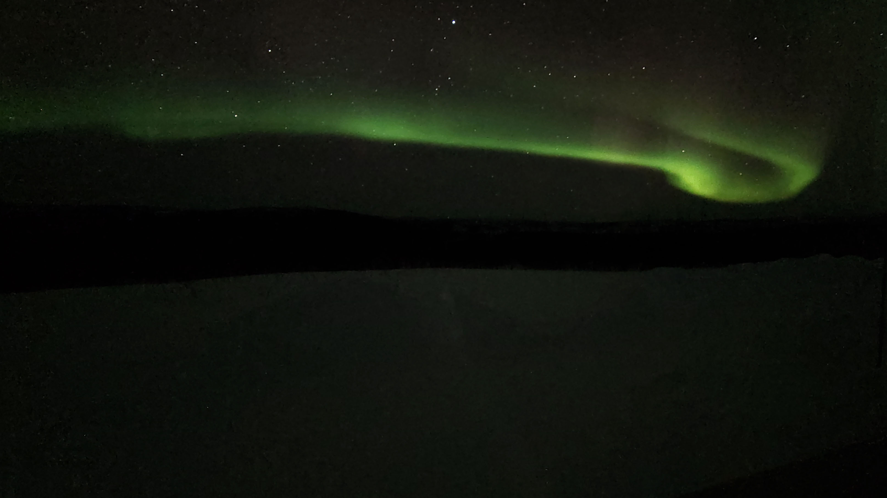


Current Continuity in Auroral System Science: A 3-D Modelling Approach to Current Closure in Non-Sheetlike Auroral Arcs
A Thesis Proposal
Jules van Irsel¹, Examining Committee: (Chair) Kristina A. Lynch¹, Yi-Hsin Liu¹, James W. LaBelle¹
¹Dartmouth College, Hanover, NH
May 10, 2022

Slide 2
Outline
Background and Motivation
Thesis Statement
Approach and Methodology
Science Studies
Tasks and Goals

Slide 3
Outline
Background and Motivation
Thesis Statement
Approach and Methodology
Science Studies
Tasks and Goals

Slide 4
Background and Motivation
“Local” Magnetosphere-Ionosphere Coupling
Discrete Auroral Precipitation
Ionospheric Ohm’s Law and Current Continuity
3-D Modelling: Why now?

Slide 5
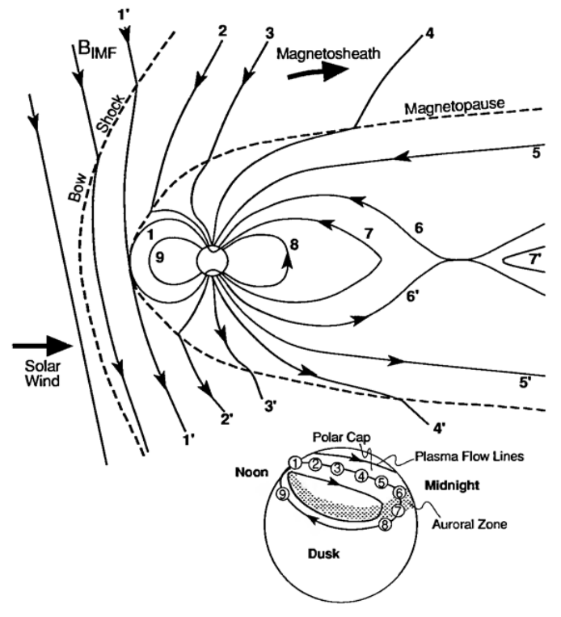
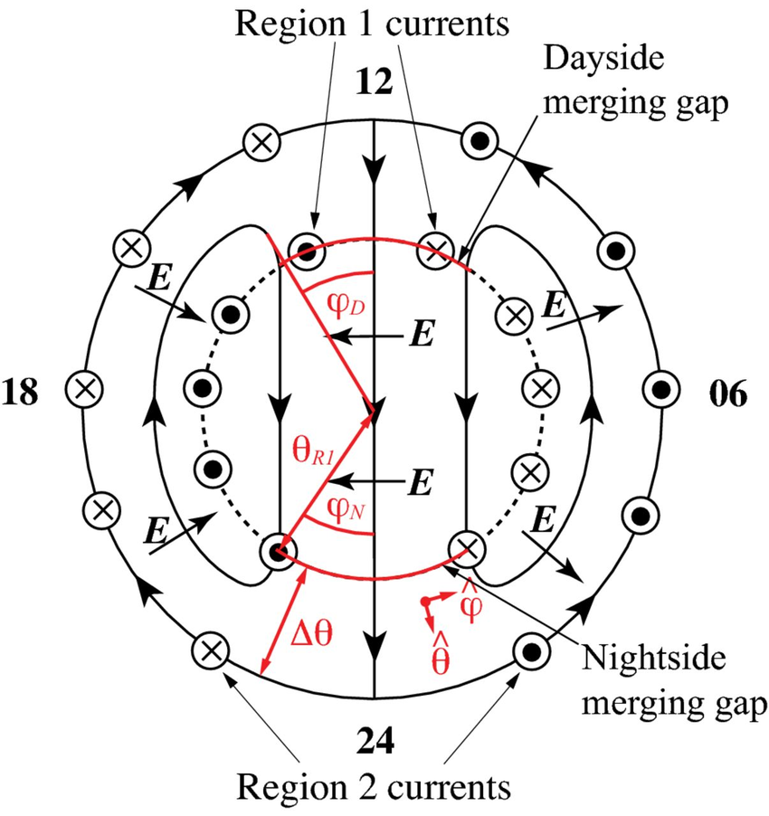
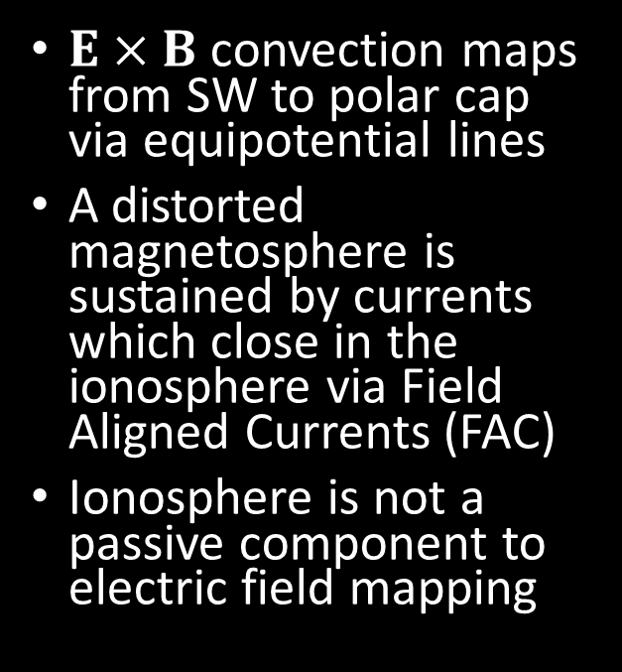
“Local” Magnetosphere-Ionosphere Coupling
$E×B$ convection maps from SW to polar cap via equipotential lines
A distorted magnetosphere is sustained by currents which close in the ionosphere via Field Aligned Currents (FAC)
Ionosphere is not a passive component to electric field mapping
From Kivelson and Russel (1995)
From Wikipedia, adapted from Cowley (2000)
Notes:
Dungey > maps ExB flow> equipotential lines E maps > converging/diverging currents in collisional ionosphere > close with FAC

Slide 6
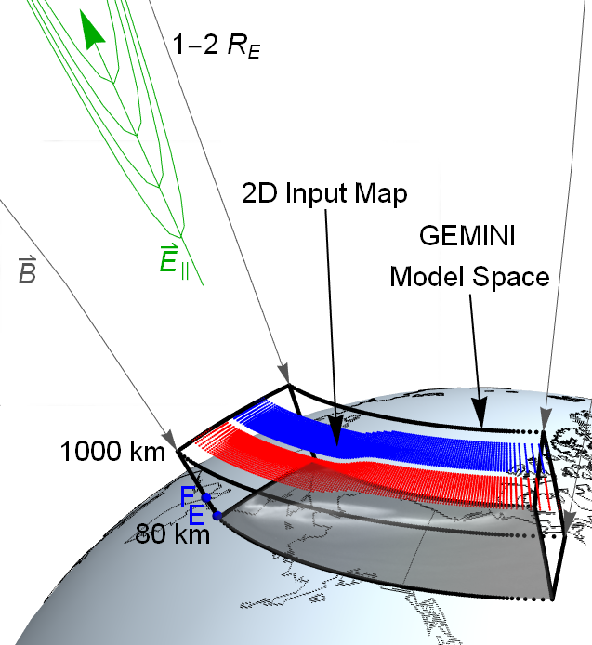
“Local” Magnetosphere-Ionosphere Coupling
The ionospheric response depends heavily on its conductivity
Auroral conductivity is highly sensitive to electron precipitation
This precipitation is thin and largely longitudinally aligned (sheetlike) but dynamic and locally structured such that current closure is non-trivial
Alfvénic, inductive MI coupling can also play a role
Notes:
NON SHEETLIKE

Slide 7
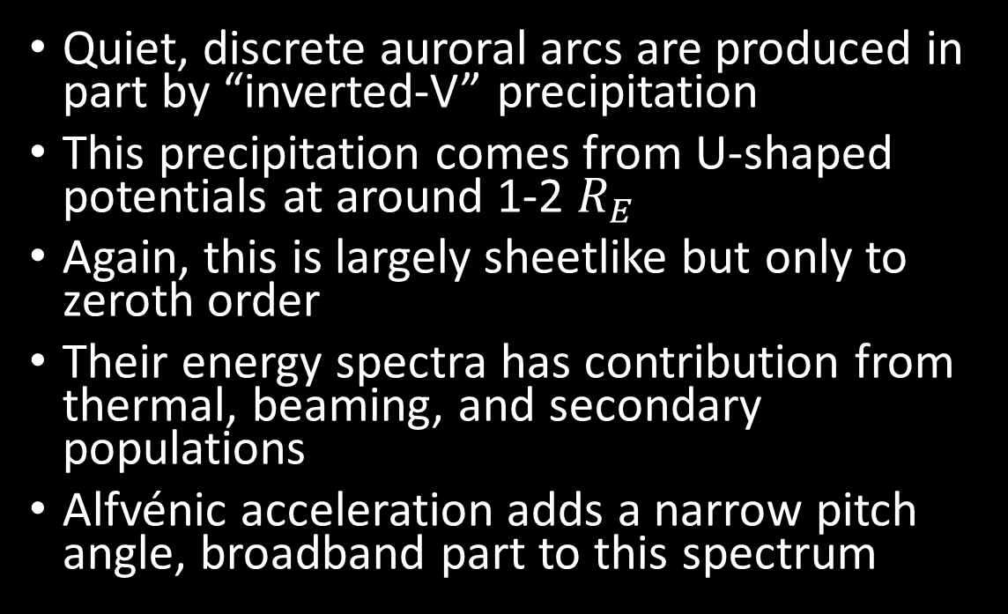
Discrete Auroral Precipitation
Quiet, discrete auroral arcs are produced in part by “inverted-V” precipitation
This precipitation comes from U-shaped potentials at around 1-2 $R_{E}$
Again, this is largely sheetlike but only to zeroth order
Their energy spectra has contribution from thermal, beaming, and secondary populations
Alfvénic acceleration adds a narrow pitch angle, broadband part to this spectrum

Slide 8
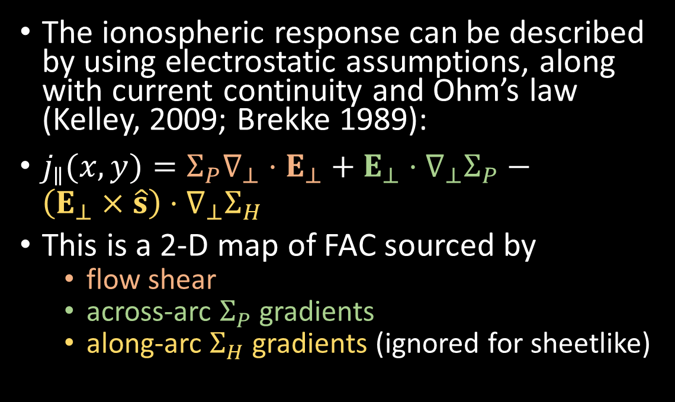
Ionospheric Ohm’s Law and Current Continuity
The ionospheric response can be described by using electrostatic assumptions, along with current continuity and Ohm’s law (Kelley, 2009; Brekke 1989):
$j_{∥}(x,y)=Σ_{P}∇_{⊥}⋅E_{⊥}+E_{⊥}⋅∇_{⊥}Σ_{P}−\left(E_{⊥}×\hat{s}\right)⋅∇_{⊥}Σ_{H}$
This is a 2-D map of FAC sourced by
flow shear
across-arc $Σ_{P}$ gradients
along-arc $Σ_{H}$ gradients (ignored for sheetlike)

Slide 9
3-D Modelling: Why now?
The sheetlike assumptions captures a lot of auroral physics, so early instruments and models were 2-D at most
Recent missions (THEMIS-GBO, EISCAT3D, SWARM, etc.) have made the 3-D picture much more accessible
Along comes 3-D modelling

Slide 10
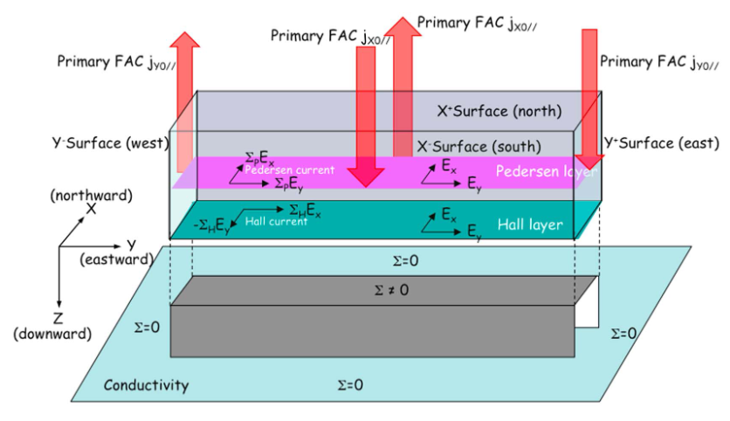
3-D Modelling: Why now?
Limited 3-D ionospheric modelling exists
Fujii et al. (2011) formulated the 3-D Cowling channel to allow diverging ionospheric currents more closure pathways
From Fujii et al. (2011)

Slide 11
3-D Modelling: Why now?
A true description of the 3-D current closure path is still an open area of study
Pedersen closure includes Joule heating, while Hall closure is non-dissipative, so it directly affects the ionospheric load description
Current closure is relatively well-posed for sheetlike arcs, but the system is inherently 3-D and requires a 3-D treatment in order to find which set of FAC and flow drivers are self-consistent
Notes:
Isinglass, ARCS, dissapationless Hall became interesting

Slide 12
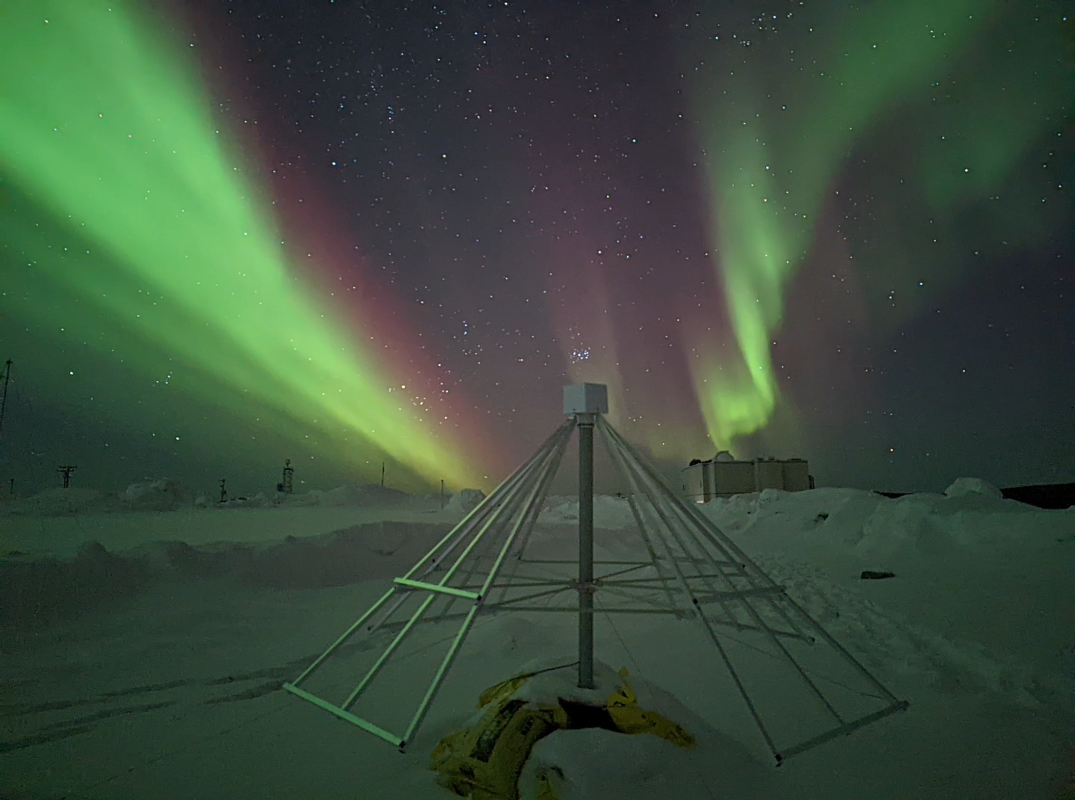
3-D Modelling: Why now?
In 3-D auroral system science, the way the ionosphere chooses to balance out the electric fields and currents is non-trivial
The solution that’s physical and self-consistent is an open area of study
Ultimately, we aim to be able to “read” the aurora by better understanding what its visual signatures communicate about the system
Credit: Mykhaylo S. Shumko

Slide 13
Outline
Background and Motivation
Thesis Statement
Approach and Methodology
Science Studies
Tasks and Goals

Slide 14
Thesis Statement
The scope of this work will address the incomplete description of auroral arcs that stray from their basic, sheet-like morphology.
The aim is to find physical, self-consistent solutions to the ionospheric current continuity equation using state-of-the-art ionospheric 3-D modelling to provide insight into the role the ionosphere plays in MI coupling for less idealized auroral events.
In particular, knowing the portions of FAC closed by Pedersen currents, which produce collisional Joule heating, versus Hall currents, which are non-dissipative, gives insight into the extent to which the ionosphere acts as a load to a magnetospheric generator.
Secondary to this, the extent to which inductive Alfvénic MI coupling affects this electrostatic picture will be investigated.

Slide 15
Outline
Background and Motivation
Thesis Statement
Approach and Methodology
Science Studies
Tasks and Goals

Slide 16
Approach and Methodology
The 3-D GEMINI Model
Data Based 2-D Driving Maps
Visualization
Modular GEMINI Additions
Quasi-Static Induction Module
Poynting Theorem Constraint Module

Slide 17
The 3-D GEMINI Model
Geospace Environment Model of Ion-Neutral Interactions
2-D: Zettergren and Semeter (2012)
3-D: Zettergren et al. (2015)
Multi-Fluid: 6 ion species + electrons
Quasi-electrostatic

Slide 18
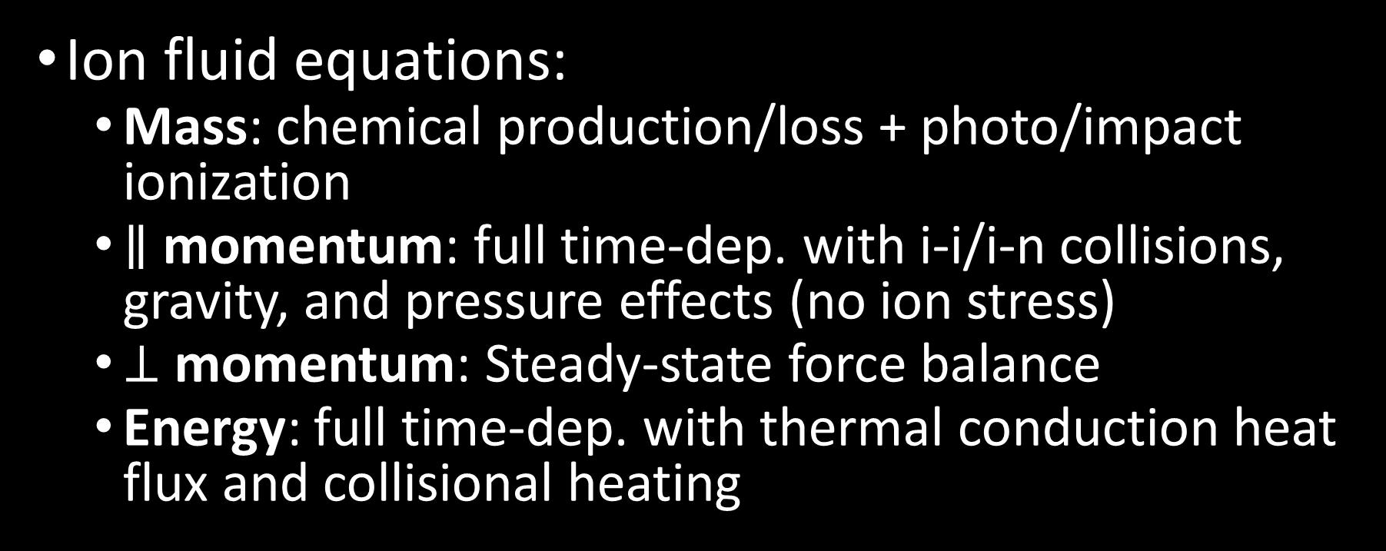
The 3-D GEMINI Model
Ion fluid equations:
Mass: chemical production/loss + photo/impact ionization
$∥$ momentum: full time-dep. with i-i/i-n collisions, gravity, and pressure effects (no ion stress)
$⊥$ momentum: Steady-state force balance
Energy: full time-dep. with thermal conduction heat flux and collisional heating

Slide 19
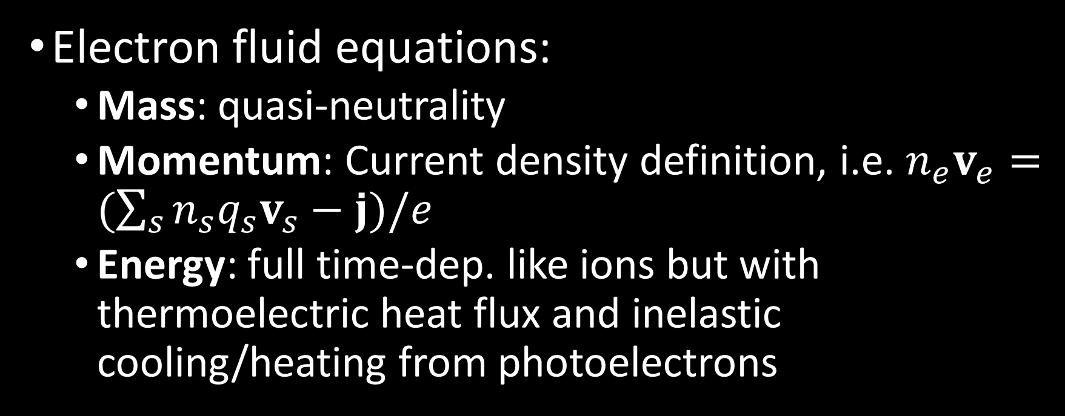
The 3-D GEMINI Model
Electron fluid equations:
Mass: quasi-neutrality
Momentum: Current density definition, i.e. $n_{e}v_{e}=(\sum_{s}{n_{s}q_{s}v_{s}}−j)/e$
Energy: full time-dep. like ions but with thermoelectric heat flux and inelastic cooling/heating from photoelectrons

Slide 20
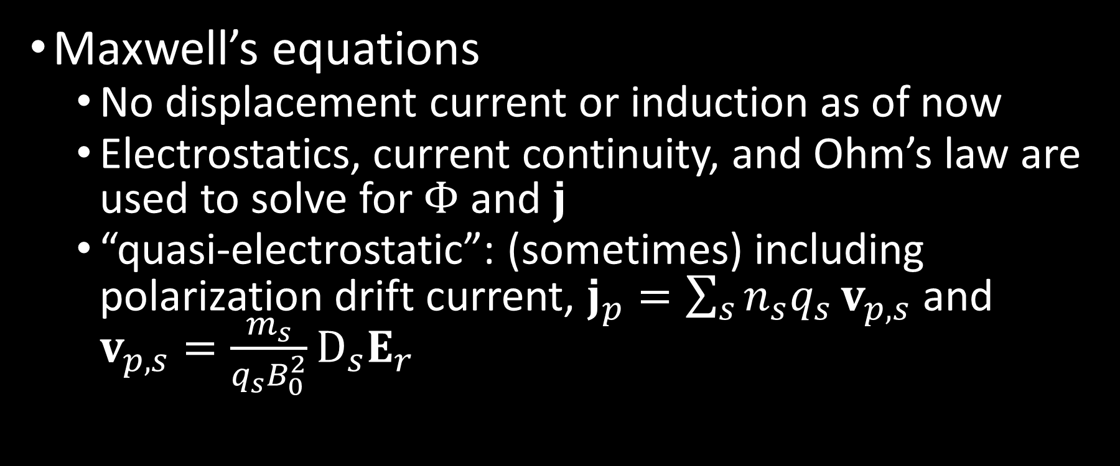
The 3-D GEMINI Model
Maxwell’s equations
No displacement current or induction as of now
Electrostatics, current continuity, and Ohm’s law are used to solve for $Φ$ and $j$
“quasi-electrostatic”: (sometimes) including polarization drift current, $j_{p}=\sum_{s}{n_{s}q_{s}}v_{p,s}$ and $v_{p,s}=\frac{m_{s}}{q_{s}B_{0}^{2}}D_{s}E_{r}$

Slide 22
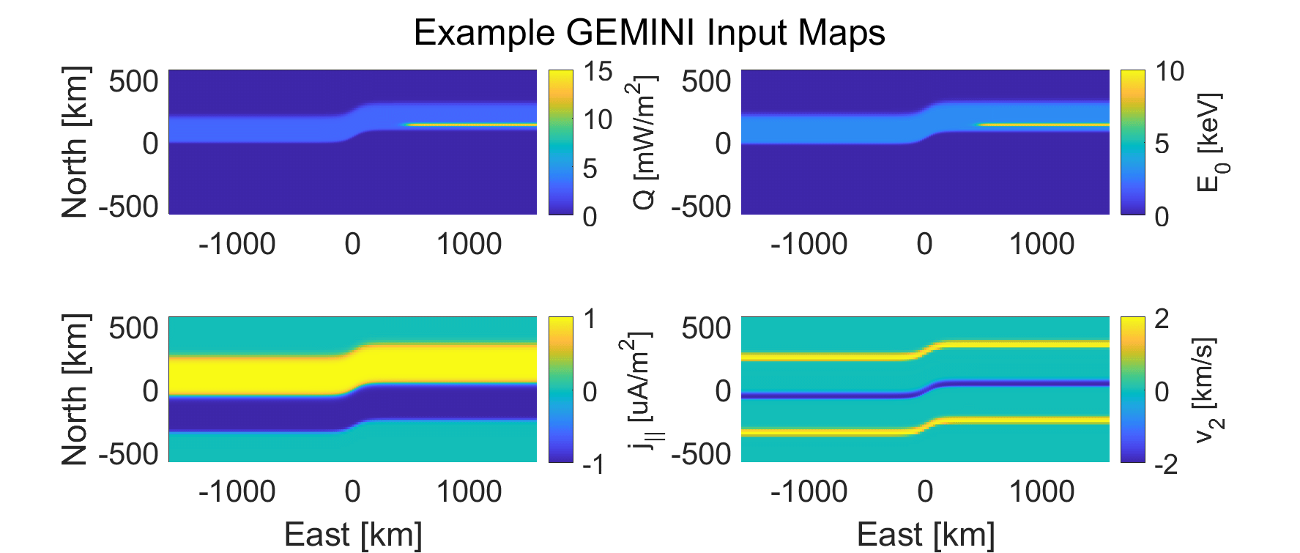
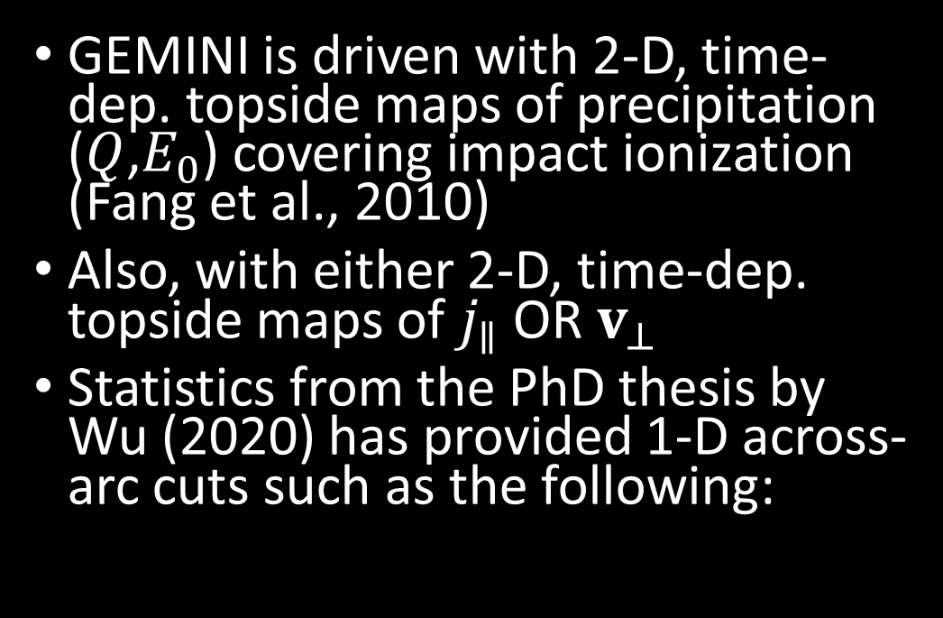
Data Based 2-D Driving Maps
GEMINI is driven with 2-D, time-dep. topside maps of precipitation ($Q$,$E_{0}$) covering impact ionization (Fang et al., 2010)
Also, with either 2-D, time-dep. topside maps of $j_{∥}$ OR $v_{⊥}$
Statistics from the PhD thesis by Wu (2020) has provided 1-D across-arc cuts such as the following:

Slide 23
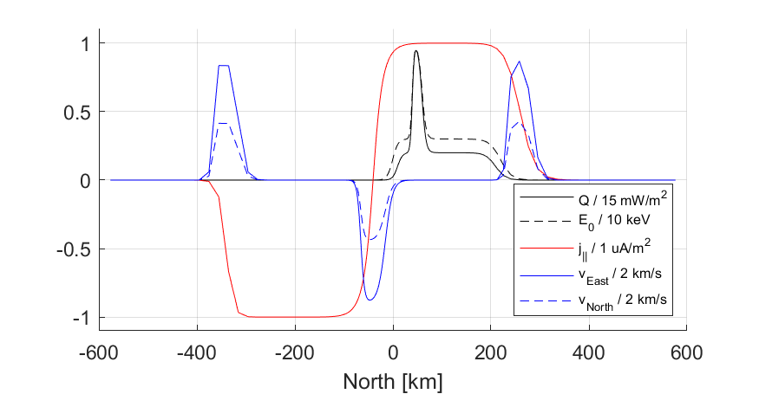
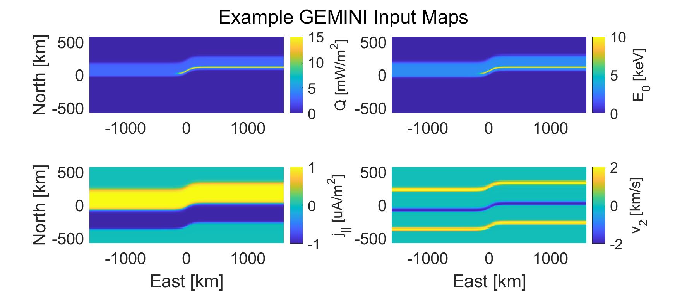
Methods from Clayton et al. (2019)

Slide 24
Methods from Clayton et al. (2019)

Slide 25
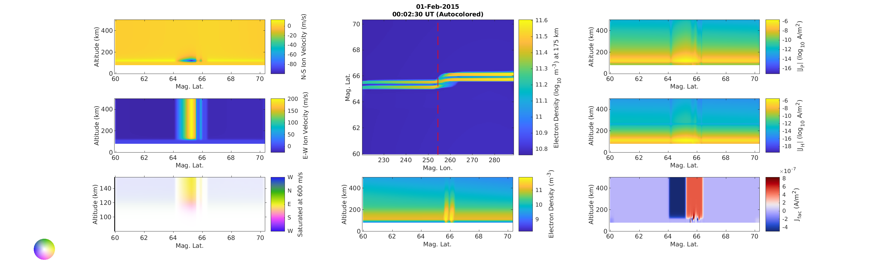
2-D Slices of GEMINI Output Datacube: FAC driven

Slide 26
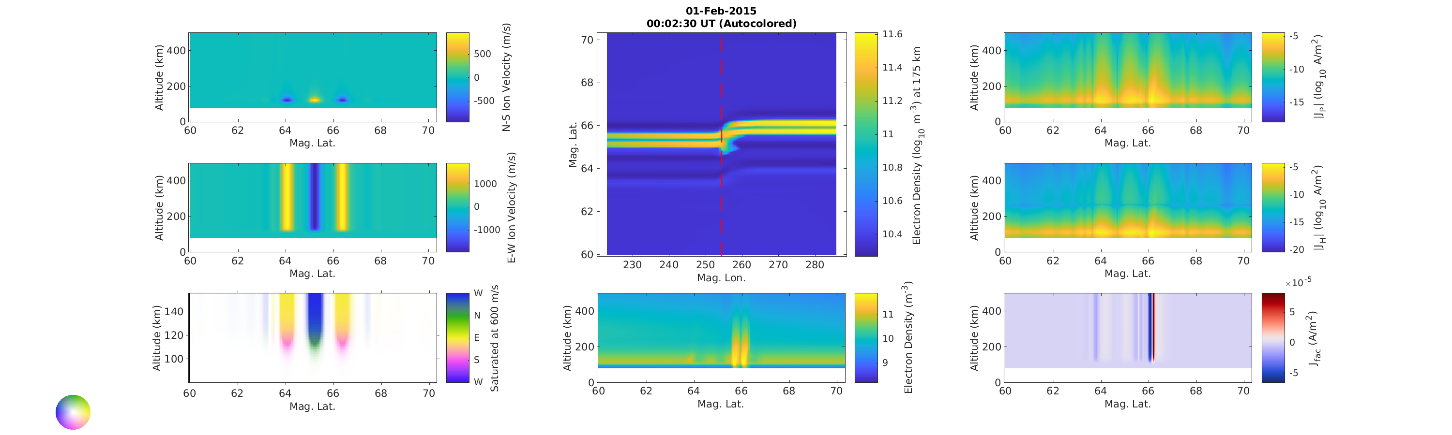
2-D Slices of GEMINI Output Datacube: Flow driven

Slide 27
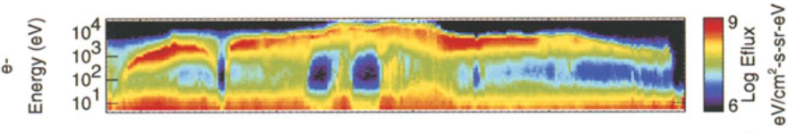
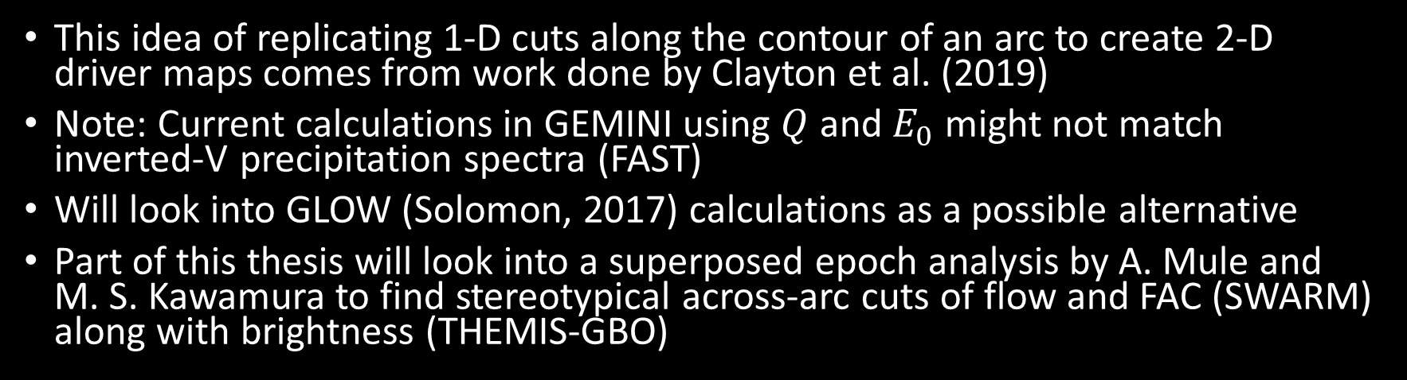
Data Based 2-D Driving Maps
Adapted from Figure 4.3 in Paschmann et al. (2003)
This idea of replicating 1-D cuts along the contour of an arc to create 2-D driver maps comes from work done by Clayton et al. (2019)
Note: Current calculations in GEMINI using $Q$ and $E_{0}$ might not match inverted-V precipitation spectra (FAST)
Will look into GLOW (Solomon, 2017) calculations as a possible alternative
Part of this thesis will look into a superposed epoch analysis by A. Mule and M. S. Kawamura to find stereotypical across-arc cuts of flow and FAC (SWARM) along with brightness (THEMIS-GBO)

Slide 28
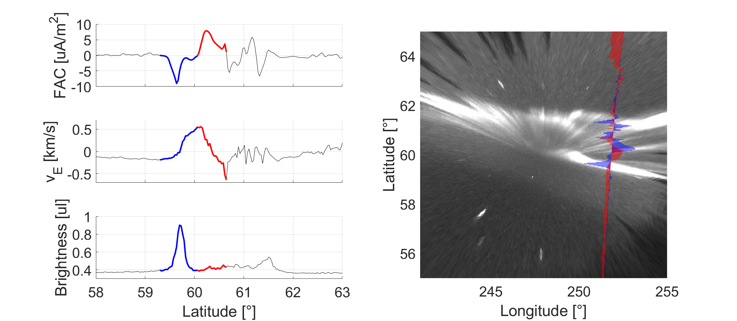
The compilation of this figure was made using data reduced by A. Mule and M. S. Kawamura. Data provided by ESA’s SWARM and the THEMIS-GBO Missions.

Slide 29
Visualization
In order to interpret the GEMINI output, standardized 3-D visualization tools will be developed using ParaView

Slide 30
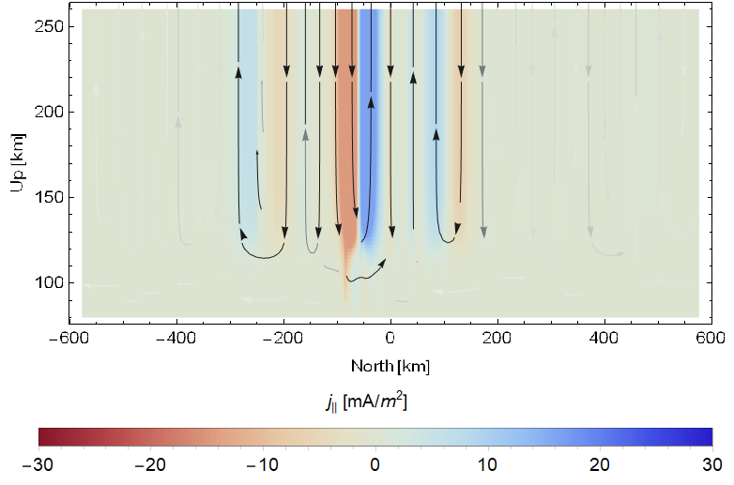
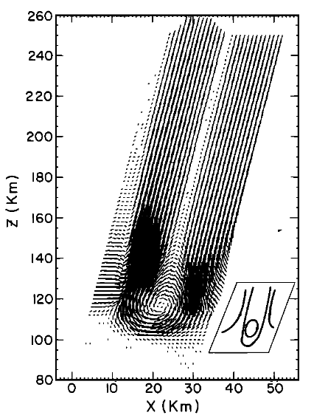
From Mallinckrodt (1985)

Slide 31
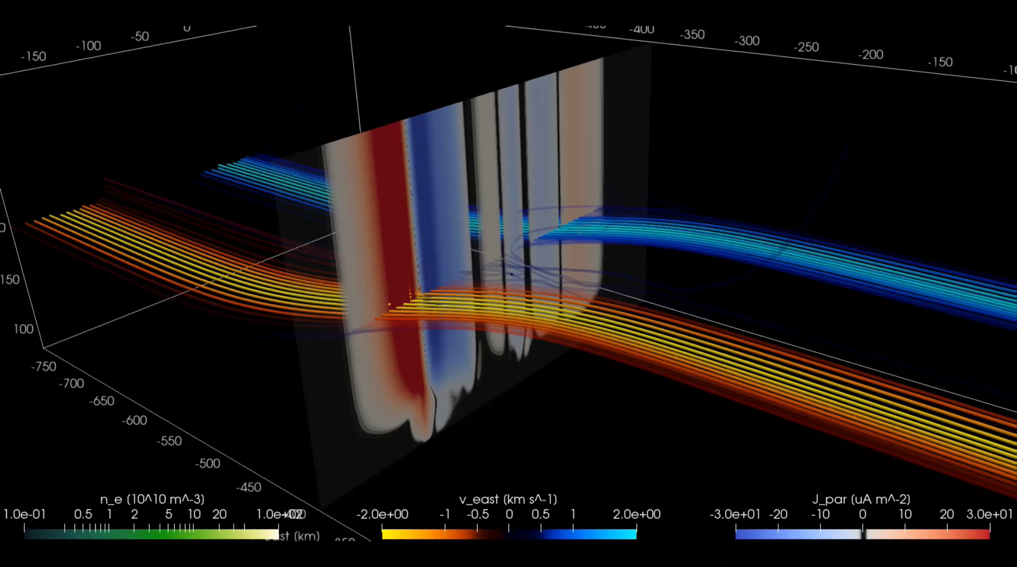
Notes:
ALONG ARC DIRECTION CLOSURE

Slide 32
Modular GEMINI Additions
Quasi-static induction module
In order for GEMINI to investigate Alfvénic, induction MI coupling we will modularly add induction to GEMINI
An approach to doing this is detailed in the thesis proposal document
Poynting theorem constraint module
A possible second module would include bookkeeping of EM energy to allow for a Poynting theorem constraint

Slide 33
Outline
Background and Motivation
Thesis Statement
Approach and Methodology
Science Studies
Tasks and Goals

Slide 34
Science Studies
Quasi-Electrostatic Studies
Comparative Induction Studies

Slide 35
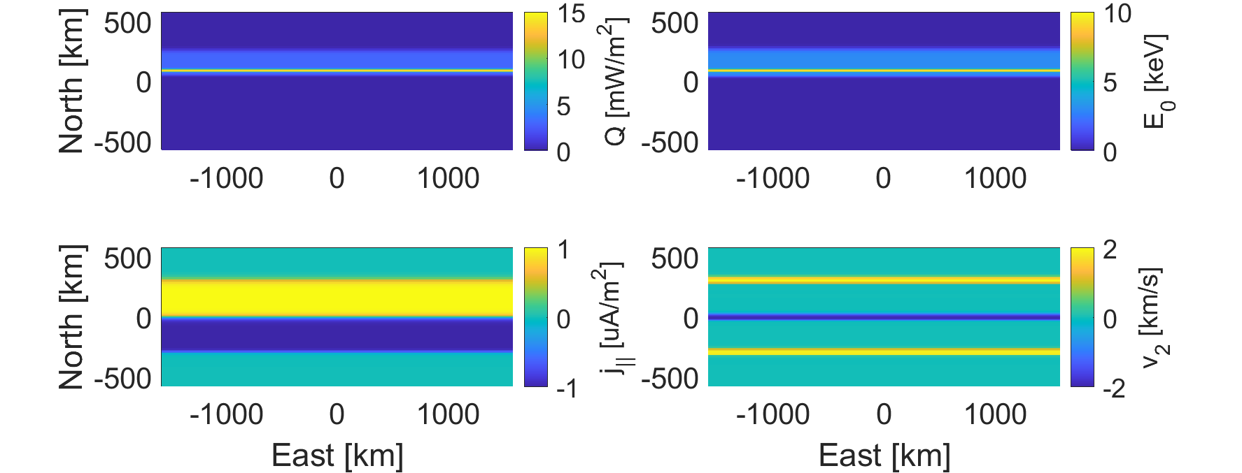
Electrostatic Studies
Baseline: 1-D across-arc cut, replicated along a straight arc contour
Used to properly compare against any introduced structure as well as literature 2-D model results
One FAC and one flow driven
Provides the 1-D flow cut calculated by GEMINI when driven with FAC, and vice versa, for future input use

Slide 36
Baseline

Slide 37
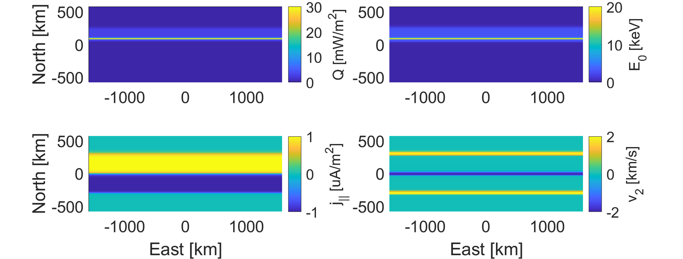
Electrostatic Studies
A straight arc contour with high intensity precipitation reaching down to the Hall current layer
How likely does, and what portions of, FAC close with Hall v. Pedersen current when given the chance?

Slide 38
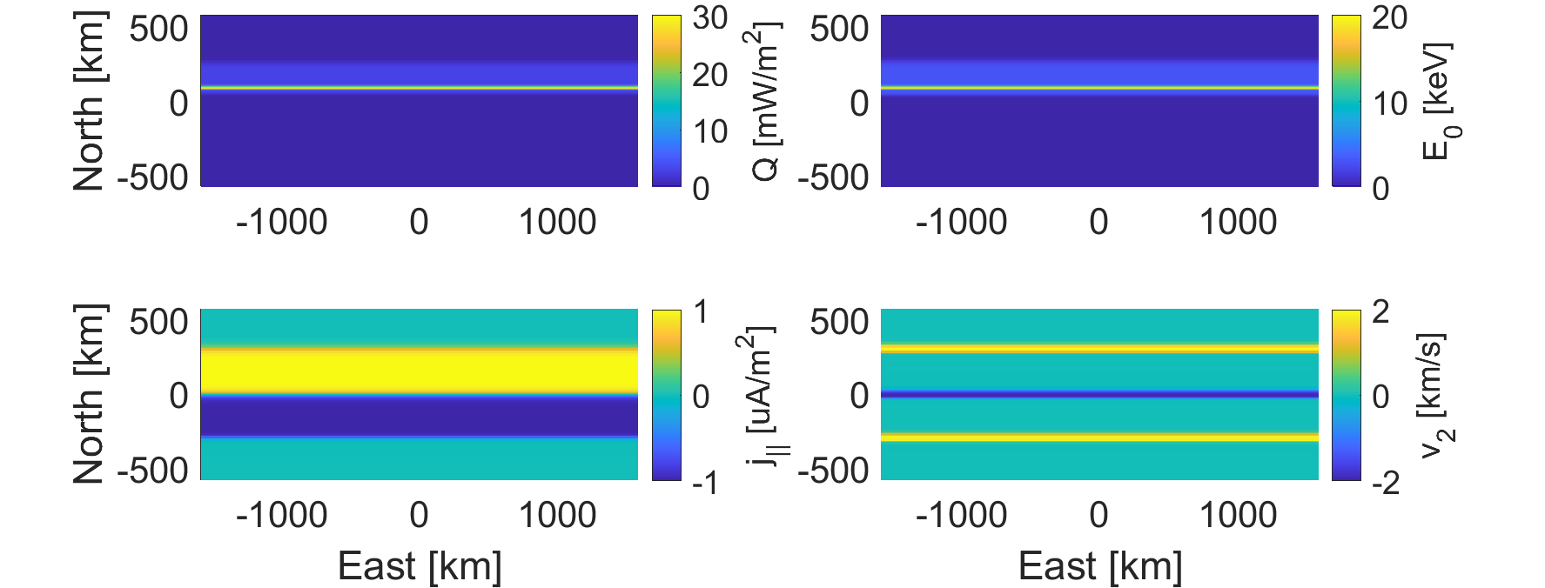
High Intensity Precipitation

Slide 39
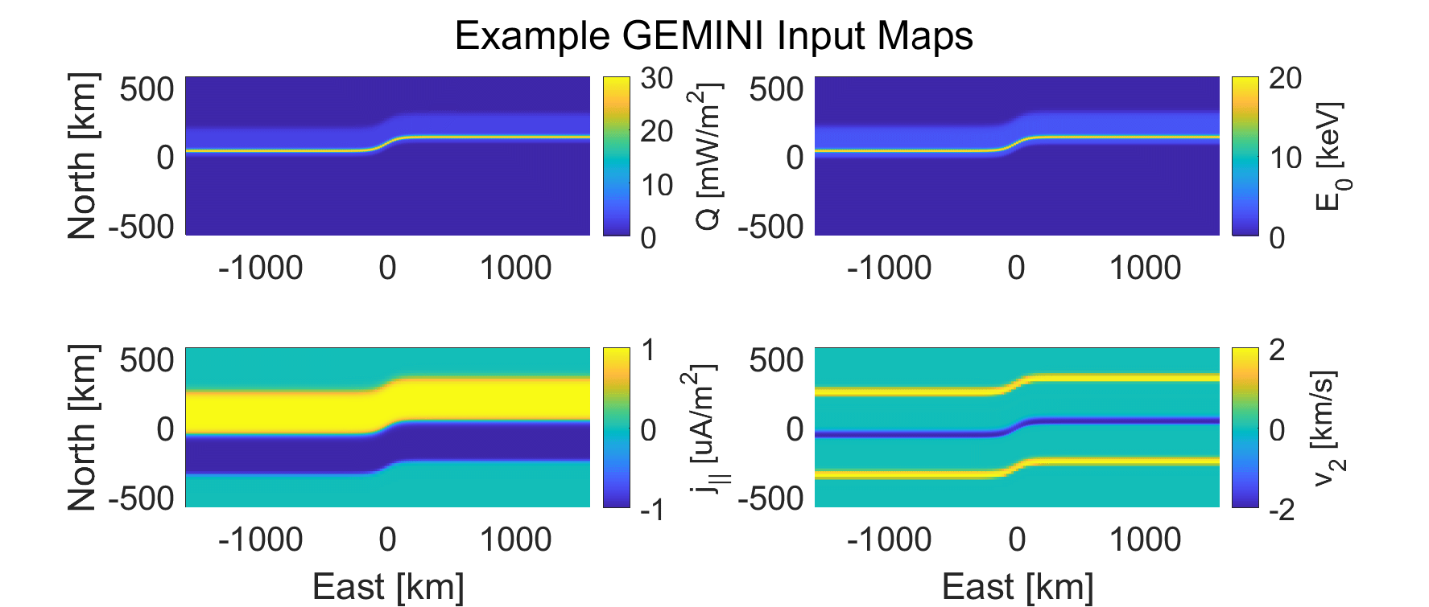
Electrostatic Studies
A bent arc contour with no drift motions
Does minor along-arc structure alone change the path of current closure?
A bent arc contour that drifts westward
How do transport and finite recombination times introduce artifacts from conductance gradients?

Slide 40

Bent

Slide 41
Bent Moving

Slide 42
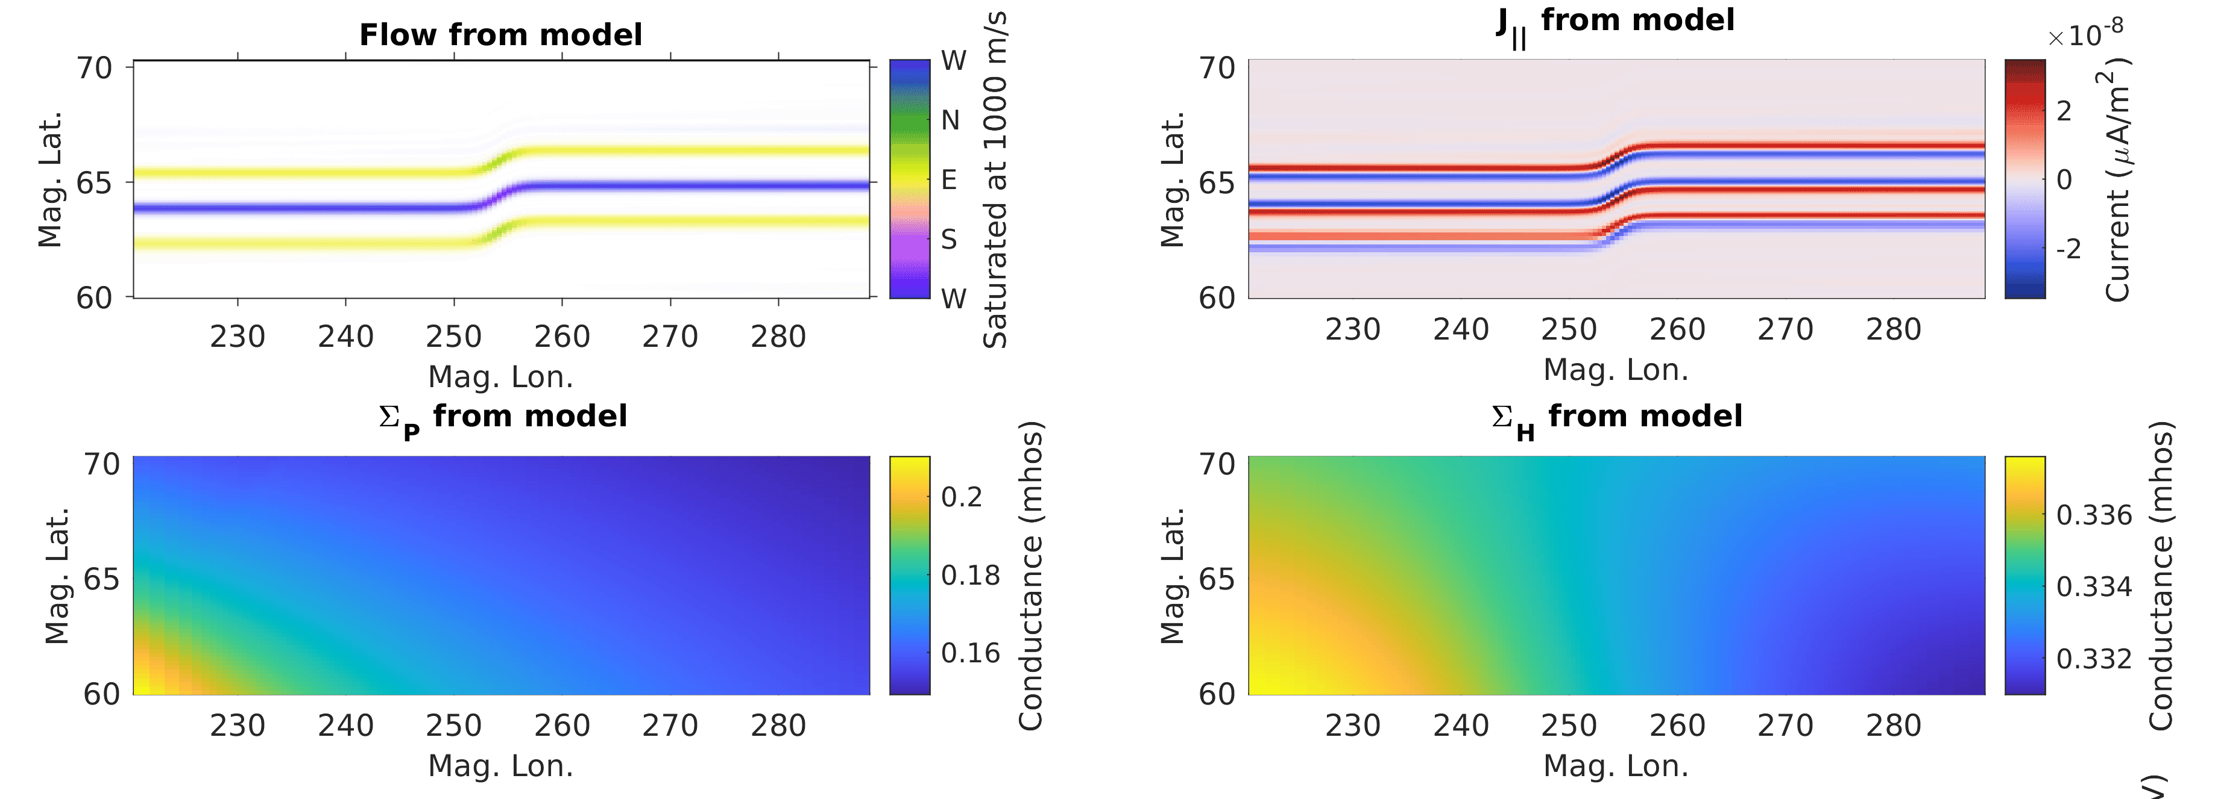
Notes:
ZOOM IN ON ARTIFACT FILIMANTARY CURRENT

Slide 43
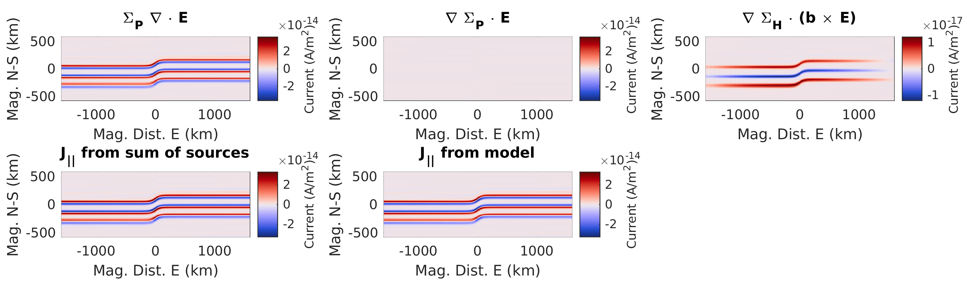

Slide 44

Electrostatic Studies
Medium intensity, thin precipitation embedding itself onto low intensity background precipitation over time
How does the more intense precipitation affect current closure inside the Cowling channel as it transitions?

Slide 45
Precipitation Fade-in

Slide 46

Electrostatic Studies
A short arc (sharc): medium intensity precipitation that falls off longitudinally
How does the medium precipitation transition to the low precipitation spatially?
How does it compare to the shortened Cowling channel by Fujii et al.?
A sharc that surges westward, a.k.a. loading bar
How does the transitional region from above act as a surge head?
Notes:
SHARC AND LOADING BAR SEEN AT PFRR

Slide 47

Sharc

Slide 48
Loading Bar

Slide 49

Electrostatic Studies
Combinations of the above: equatorward drift + westward drift + sharc + loading bar
What are the limits of along-arc structure in this quasi-static picture? When does the FAC become thin and strong to introduce instabilities?
Notes:
REFERENCE TED’S THESIS WORK

Slide 50
Combinations

Slide 51
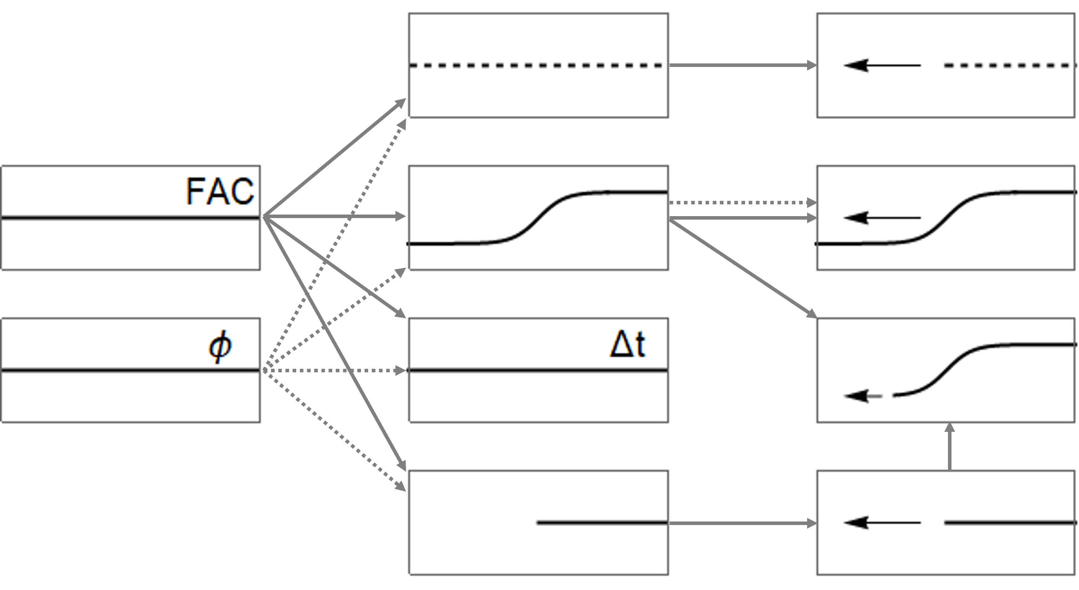

Slide 52
Comparative Induction Studies
After implementing and testing of the induction module in GEMINI, a study will compare
GEMINI Classic
GEMINI with induction suppressed (somehow)
GEMINI with full induction
When can Alfvénic MI coupling not be ignored in GEMINI?
2-D at first due to computational limits

Slide 53
Closure
Science closure will require some formulation of metrics for output parameters that can be plotted against input parameters
E.g. a metric that determines the fraction of Pedersen v. Hall current closure, plotted against the degree of arc bend

Slide 54
Closure
With this outlined approach and using these science studies, I am excited to start investigating this compelling science
Can we learn to “read” the aurora?
Can we use the visual signatures of the aurora to determine its system science
Credit: Mykhaylo S. Shumko

Slide 55
Outline
Background and Motivation
Thesis Statement
Approach and Methodology
Science Studies
Tasks and Goals

Slide 56
Tasks and Goals
Finished Work
Unfinished Work
Academic Year 3
Academic Year 4
Academic Year 5

Slide 57
Finished Work
My work on numerous OSSEs during the ARCs CSR has made me familiar with GEMINI as well as typical auroral arc structures
My work on reconstructing 2-D flow maps from distributed mock s/c measurements has provided this project with tools to drive GEMINI with potential maps
I have started looking into the source code and gained a superficial understanding of the GEMINI model in order to address the physics introduced by induction

Slide 58
Finished Work
2021 AGU Fall Meeting: I gave a talk on “The Effect of Hall Conductance Gradients in Non-Sheet-Like Auroral Arcs on Field-Aligned Currents”
We concluded that “Westward moving auroral arc systems with minor bends can cause conductivity signatures which source along-arc, up-down pairs of ionospheric FAC contributed from along-arc gradients in Hall conductance”

Slide 59
Finished Work
2021 CEDAR Workshop: I presented a poster on “FAC Contributions from Hall Conductance Gradients in Non-Sheet-Like Auroral Arcs
This was preliminary work to the AGU talk with a focus on the electron density plume in the wake of a moving bend

Slide 60
Finished Work
LAMP: I helped build, tested, and integrated instruments (PIPs) onto the LAMP sounding rocket mission
This work made me more intimately familiar with the aurora themselves during the nights of the launch window
The sharc and loading bar ideas grew out of this mission

Slide 61
Unfinished Work
Academic Year 3
I will conclude this proposal work
I will have discussions with M. D. Zettergren regarding a closed system of equations for inductive GEMINI
A version of sharc and/or loading bar will be run and I will present findings at the 2022 CEDAR Workshop in June

Slide 62
Unfinished Work
Academic Year 4
I will help settle on appropriate inverted-V precipitation calculation options for GEMINI
I will investigate the SEA by A. Mule and M. S. Kawamura to open a list of stereotypical 1-D across-arc cuts
I will publish a short paper on the ARCs reconstruction algorithm I wrote
A catalogue of GEMINI simulations will be studied and I will publish a paper on any findings

Slide 63
Unfinished Work
Academic Year 4
With the help of M. D. Zettergren, I will implement the induction module into GEMINI and do a comparative study
I will submit proposals for graduate funding to the NSF and/or the GSRP
I will present at the 2022 AGU Fall Meeting and the 2023 CEDAR Workshop
I will complete PHYS 76 in order to fulfil my candidacy requirements

Slide 64
Unfinished Work
Academic Year 5
I will publish a paper on the comparative GEMINI induction study
I will present at the 2023 AGU Fall Meeting and the 2024 CEDAR Workshop
I will reach out to other research groups
I will finish writing my dissertation and defend if all goes to plan.

Slide 65
Thank you!

Slide 66
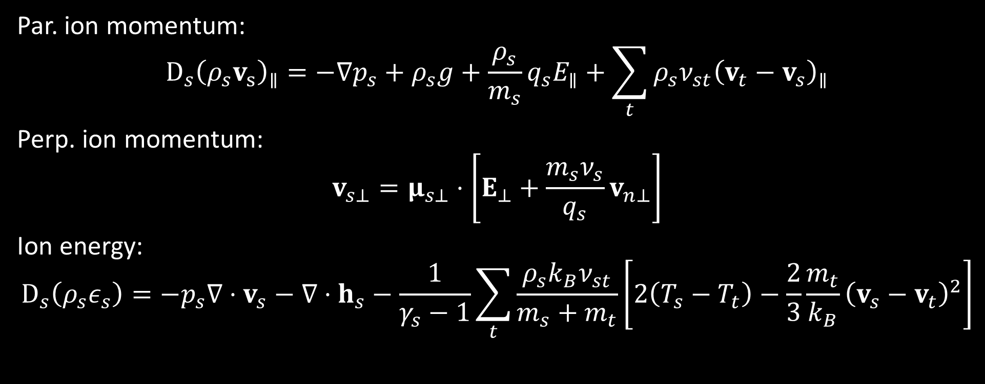
Extra Slides
Par. ion momentum:
$$D_{s}{\left(ρ_{s}v_{s}\right)}_{∥}=−∇p_{s}+ρ_{s}g+\frac{ρ_{s}}{m_{s}}q_{s}E_{∥}+\sum_{t}{ρ_{s}ν_{st}{\left(v_{t}−v_{s}\right)}_{∥}}$$
Perp. ion momentum:
$$v_{s⊥}=μ_{s⊥}⋅\left[E_{⊥}+\frac{m_{s}ν_{s}}{q_{s}}v_{n⊥}\right]$$
Ion energy:
$$D_{s}\left(ρ_{s}ε_{s}\right)=−p_{s}∇⋅v_{s}−∇⋅h_{s}−\frac{1}{γ_{s}−1}\sum_{t}{\frac{ρ_{s}k_{B}ν_{st}}{m_{s}+m_{t}}\left[2\left(T_{s}−T_{t}\right)−\frac{2}{3}\frac{m_{t}}{k_{B}}{\left(v_{s}−v_{t}\right)}^{2}\right]}$$

Slide 67
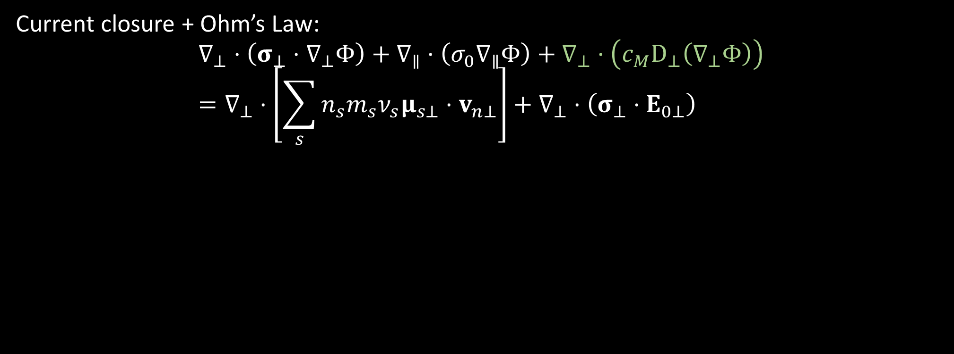
Extra Slides
Current closure + Ohm’s Law:
$$∇_{⊥}⋅\left(σ_{⊥}⋅∇_{⊥}Φ\right)+∇_{∥}⋅\left(σ_{0}∇_{∥}Φ\right)+∇_{⊥}⋅\left(c_{M}D_{⊥}\left(∇_{⊥}Φ\right)\right)=∇_{⊥}⋅\left[\sum_{s}{n_{s}m_{s}ν_{s}μ_{s⊥}⋅v_{n⊥}}\right]+∇_{⊥}⋅\left(σ_{⊥}⋅E_{0⊥}\right)$$

Slide 68
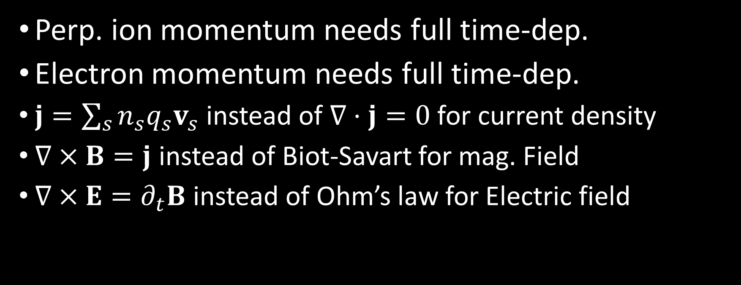
Extra Slides
Perp. ion momentum needs full time-dep.
Electron momentum needs full time-dep.
$j=\sum_{s}{n_{s}q_{s}v_{s}}$ instead of $∇⋅j=0$ for current density
$∇×B=j$ instead of Biot-Savart for mag. Field
$∇×E=∂_{t}B$ instead of Ohm’s law for Electric field

